Slide 1
Deep Learning NLP for Search (Word Embedding & RNN)

Slide 2

Neural Search

Slide 3
Challenges in Traditional Search Engines
Suppose you want to learn something about the latest research breakthroughs in artificial intelligence.
What will you do to find information?
How much time and work does it take to get the facts you’re looking for?
If you’re in a (huge) library, you can ask the librarian what books are available on the topic, and they will probably point you to a few they know about.
Ideally, the librarian will suggest particular chapters to browse in each book.
But the librarian generally comes from a different context than you do, meaning you and the librarian may have different opinions about what’s significant.
The library could have books in various languages, or the librarian might speak a different language.
Their information about the topic could be outdated, given that latest is a fairly relative point in time, and you don’t know when the librarian last read anything about artificial intelligence, or if the library regularly receives publications in the field

Slide 4
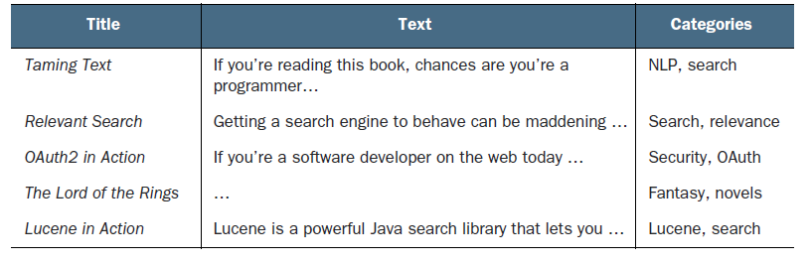
Example data for book categorization

Slide 5
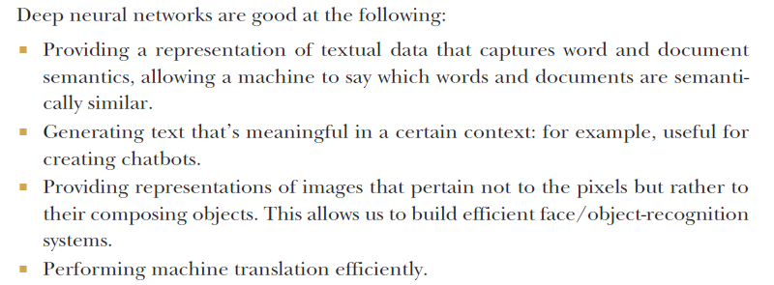
What deep learning can do for search

Slide 6
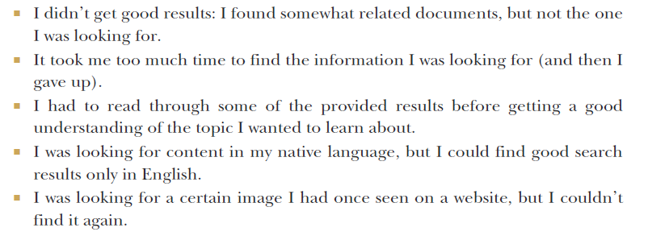
Major struggle points when using search engines

Slide 7
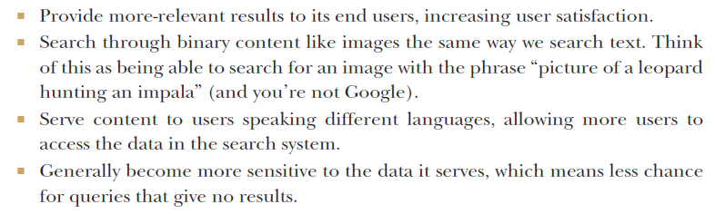
With the help of DL algorithms, a search engine is able to

Slide 8
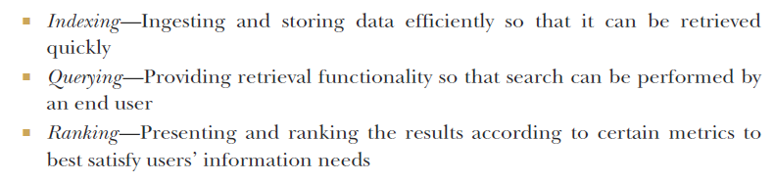
Retrieving useful information

Slide 9
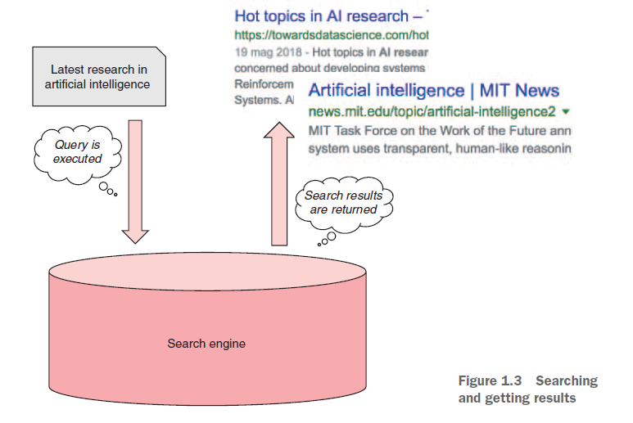
Searching
and getting results - Text, tokens, terms, and search fundamentals

Slide 10
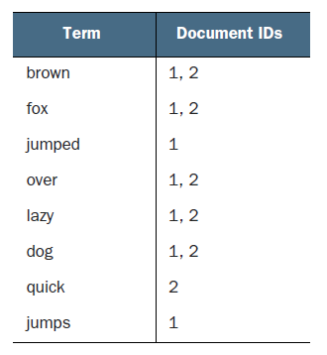
Inverted index table

Slide 11
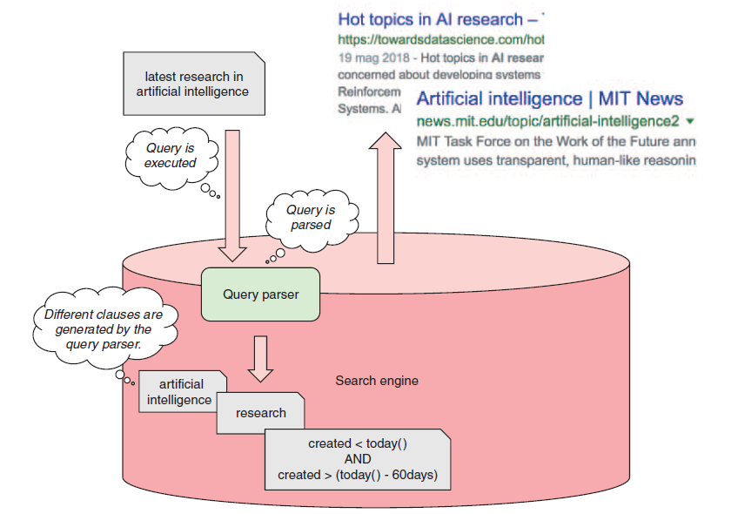
Query parsing

Slide 12
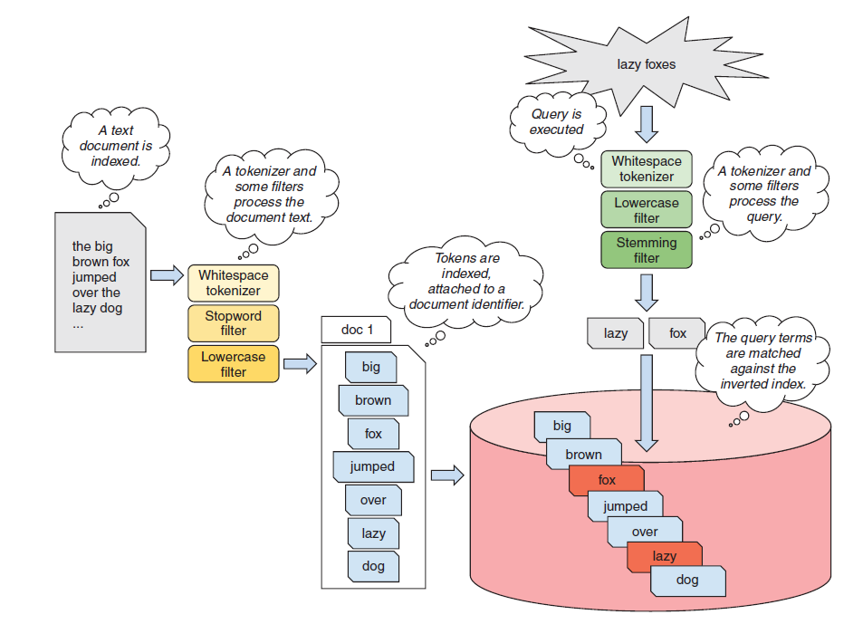
Index, search-time
analysis, and term matching

Slide 13
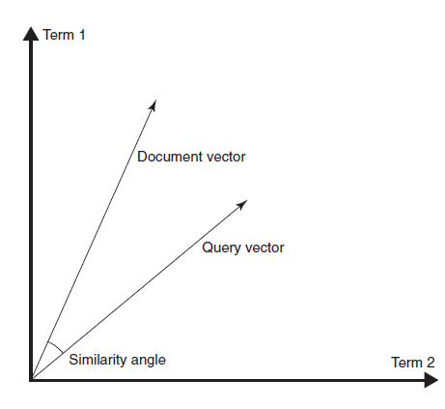
Classic retrieval models – VSM
Similarities between document and query vectors
according to VSM

Slide 14
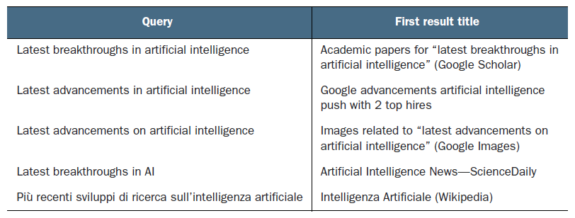
Deep NLP - Comparing similar queries

Slide 15
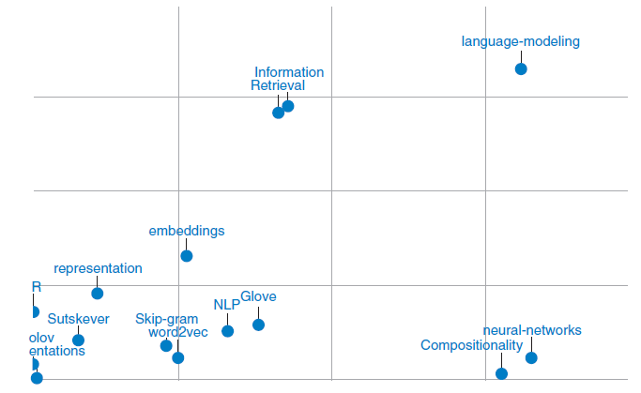
Word vectors derived from the text of research articles on word2vec

Slide 16
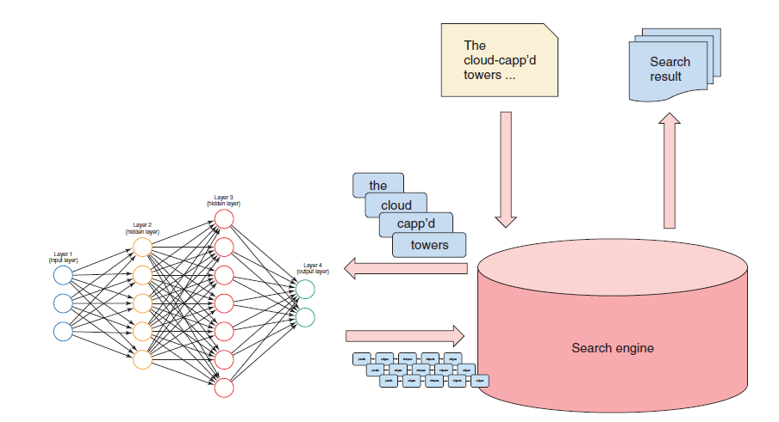
A neural search application
Using word representations generated by a deep neural network to provide more-relevant results

Slide 17

Generating Synonyms
(Word Embedding)

Slide 18
Synonyms allows to expand the number of potential ways a query or piece of indexed document is expressed.
For example, you can express the sentence “I like living in Rome” as “I enjoy living in the Eternal City”: the terms “living” and “enjoying” as well as “Rome” and “the Eternal City” are semantically similar, so the information conveyed by both sentences is mostly the same.
Synonyms could help with the problem discussed earlier, of a librarian and a student looking for a book understanding one another.
That’s because using synonyms allows people to express the same concept in different ways—and still retrieve the same search results!
Introduction to synonym expansion

Slide 19
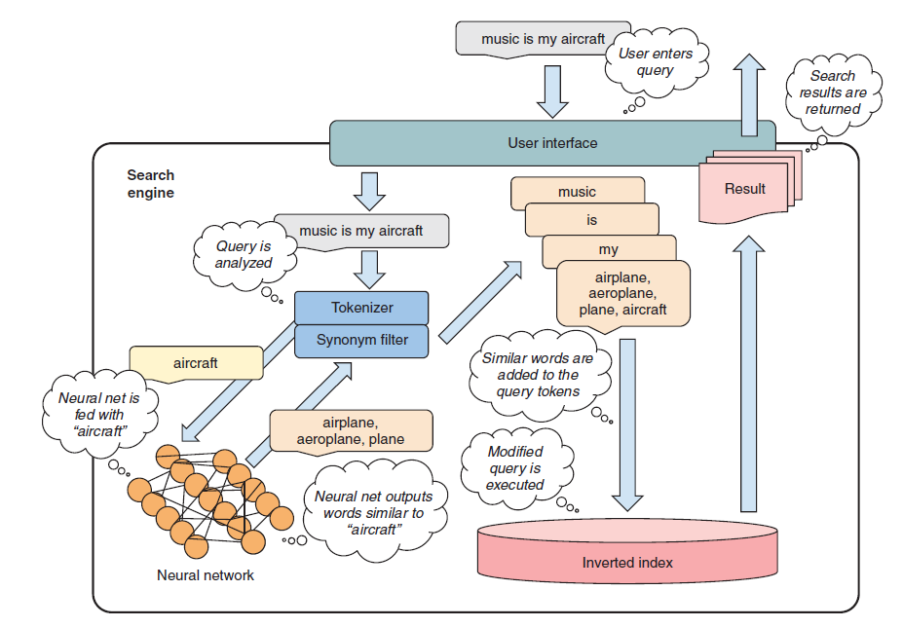
Synonym expansion at search time, with a neural network

Slide 20
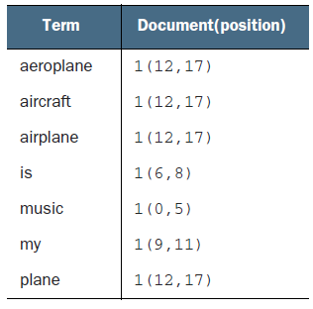
Posting list for the fragment
“music is my aeroplane”

Slide 21
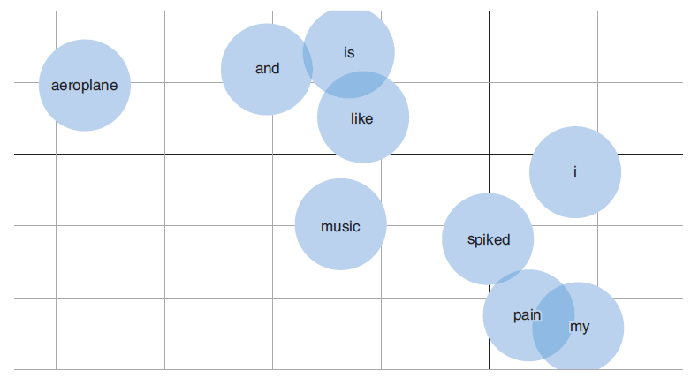
Plotted word vectors for “Aeroplane”
○ “Music” and “song” are very close semantically; you could even say they’re synonyms.
○ “Looking” and “view” are related, but “better” has nothing to do with “looking.”
○ “In,” “the,” and “like” aren’t close to each other.

Slide 22
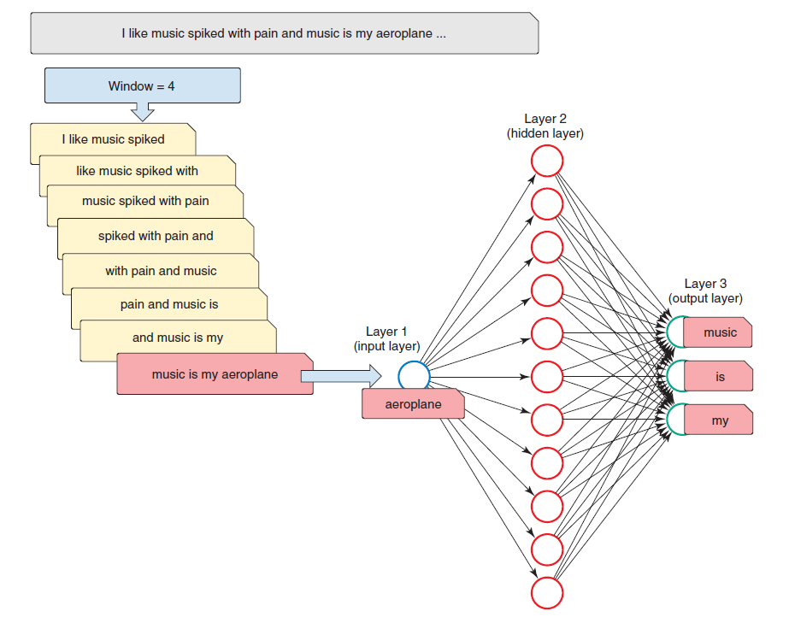
Feeding word2vec (skip-gram model) text fragments

Slide 23
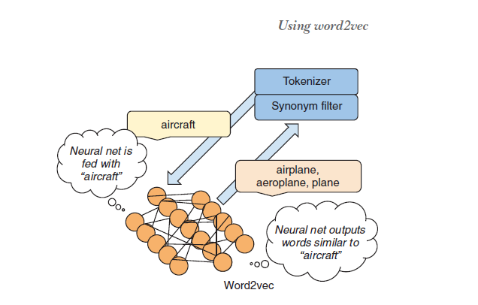
Synonym expansion
at search time, with word2vec

Slide 24
From Plain Retrieval to Text Generation

Slide 25
○ Expanding queries
○ Using search logs to build training data
○ Understanding recurrent neural networks
○ Generating alternative queries with RNNs
From plain retrieval
to text generation

Slide 26
As a user, do you really want to spend a lot of time thinking about how to word a query?
Imagine yourself on your way to work on public transport early in the morning, searching for information on your phone.
You don’t have the time or the brainpower (it’s early!) to come up with the best way to interact with a search engine
Information need vs. query: Bridging the gap

Slide 27
The goal is to produce a set of alternative queries without any interaction with the user.
Such queries should have the same or similar meaning with respect to the original query, but using different words (while still being correctly spelled).
Generating alternative queries

Slide 28
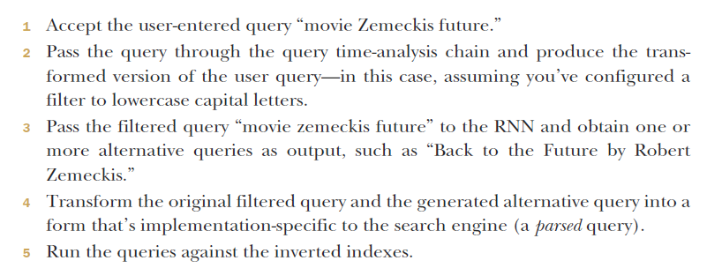
To see how this should work, let’s go back to the example of the query “movie Zemeckis future.”
If you enter that phrase, the search engine should do the following:
Generating alternative queries

Slide 29
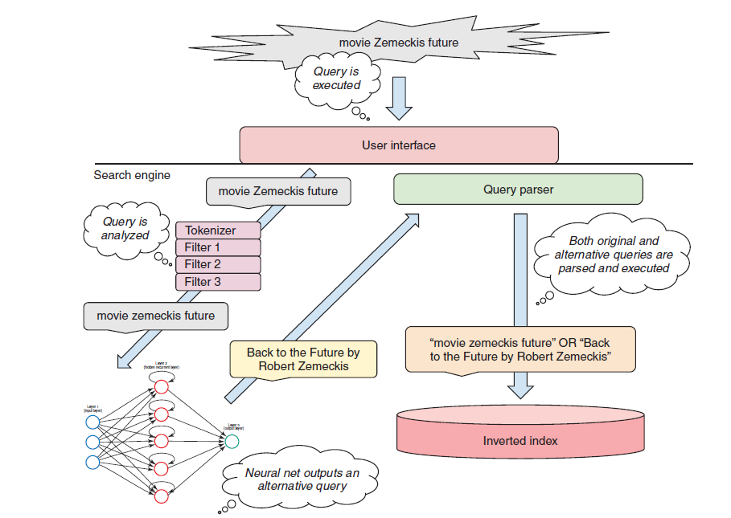
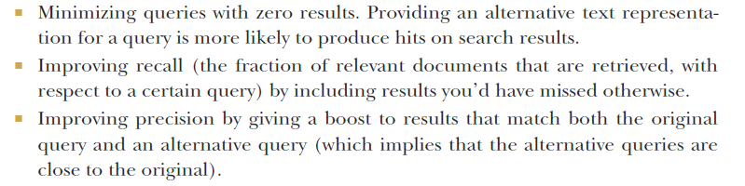
Alternative query generation

Slide 30
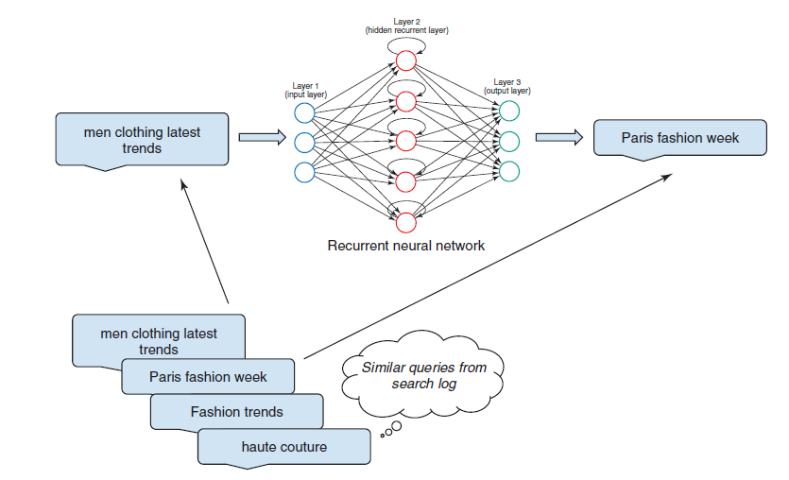
Learning from queries

Slide 31
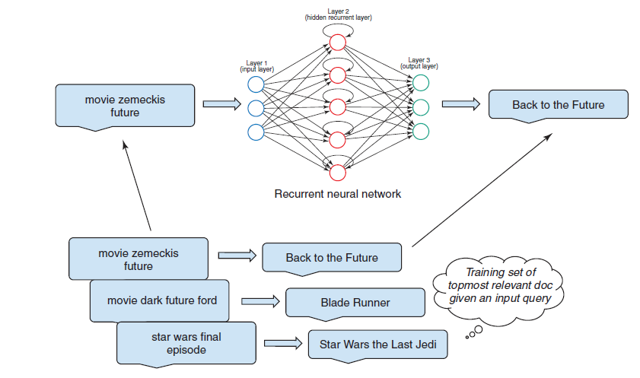
Learning from the titles of relevant documents

Slide 32
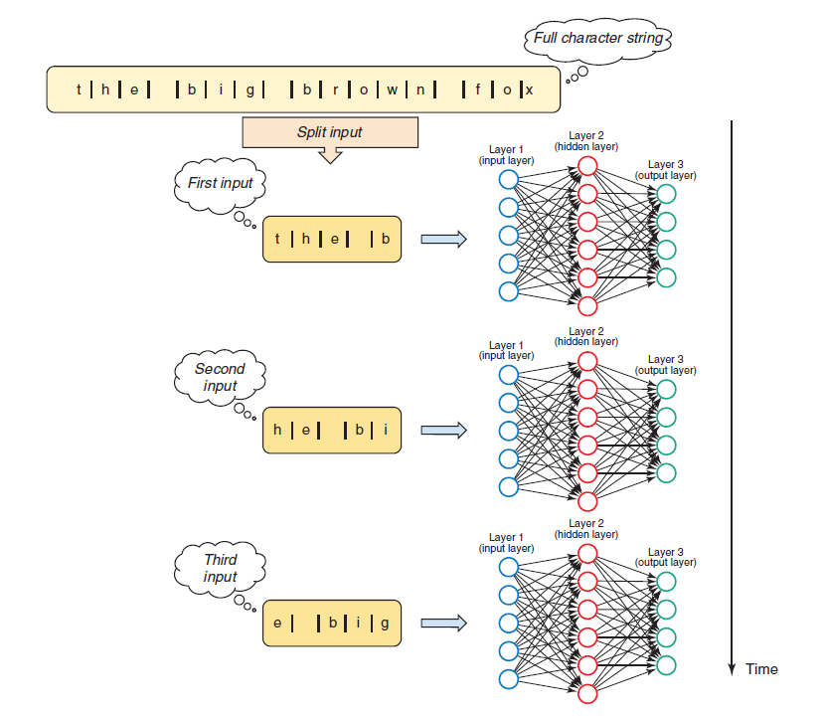
Learning over sequences – Recurrent Neural Network

Slide 33
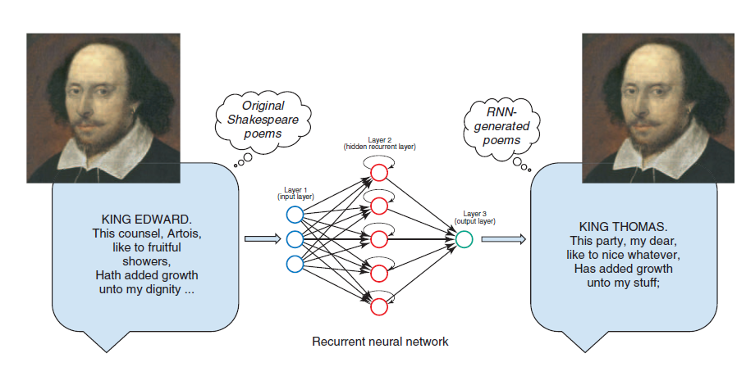
LSTM networks for unsupervised text generation - Generating Shakespearean text

Slide 34
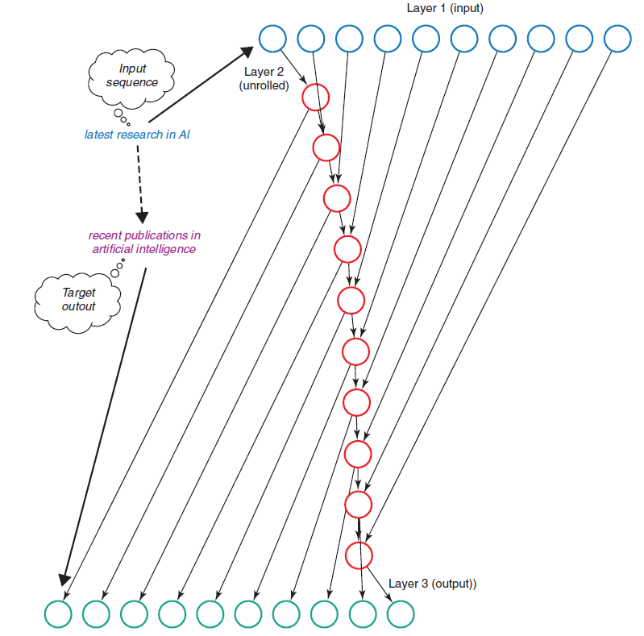
From unsupervised to supervised text generation - Sequence-to-sequence modeling

Slide 35
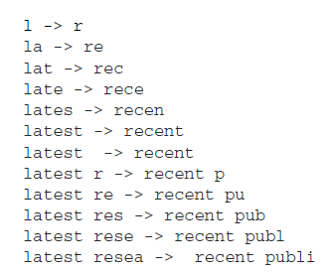
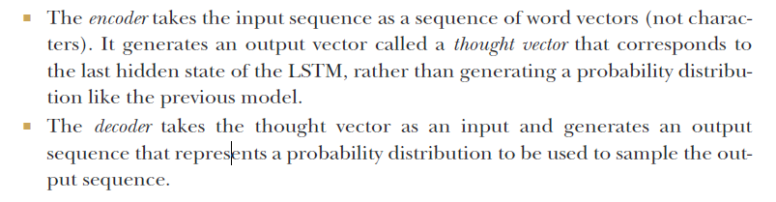
RNN/LSTM sequence-to-sequence models

Slide 36
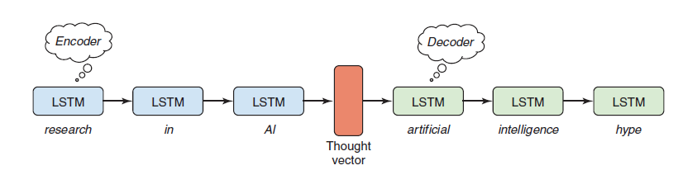
Sequence-to-sequence modeling for queries

Slide 37
More-sensitive query suggestions

Slide 38
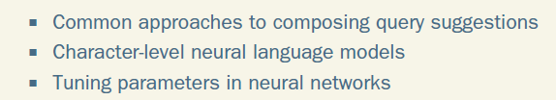
Generating query suggestions

Slide 39
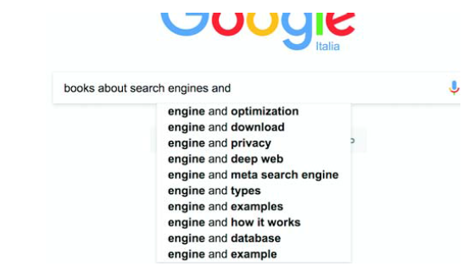
Suggestions for
“books about search engines and”

Slide 40
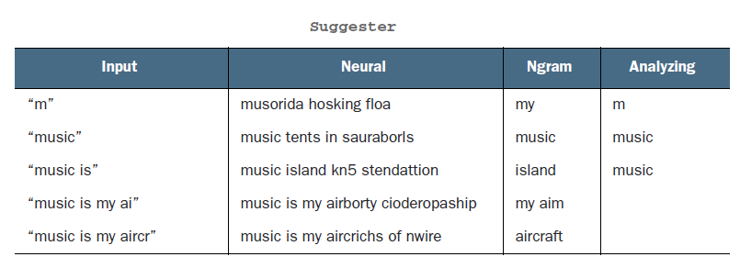
Language Modelling - Character-based neural language model for suggestions

Slide 41
Searching across languages

Slide 42
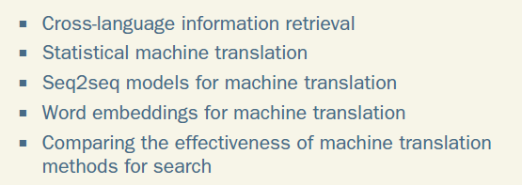
Serving users who speak multiple languages

Slide 43
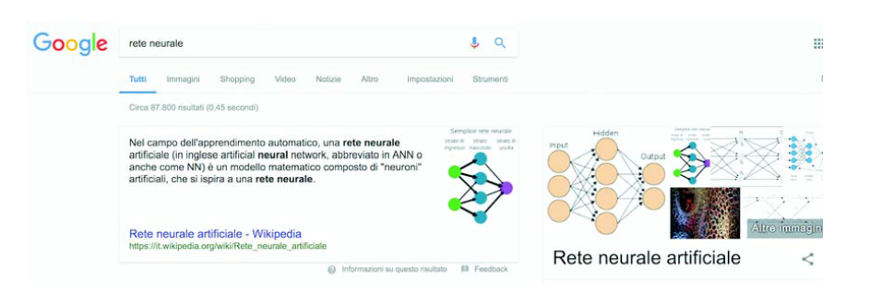
Searching for “rete neurale,” Italian for “neural network”

Slide 44
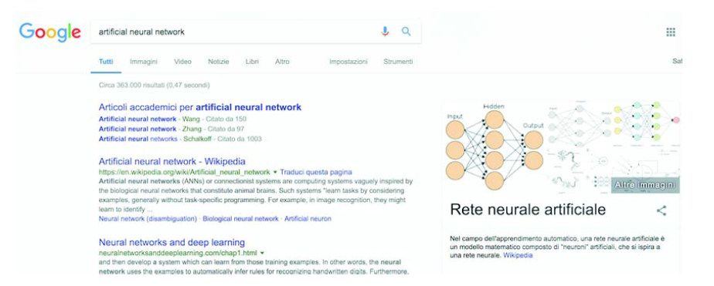
Searching for “artificial neural network” and getting results in Italian as well as English

Slide 45
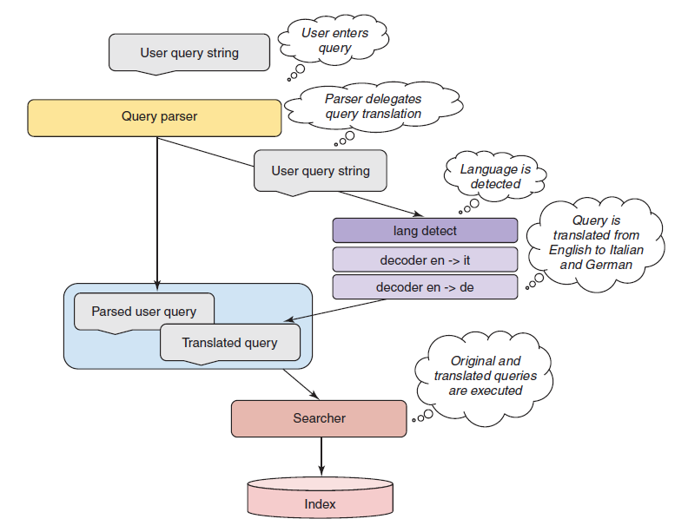
Cross-language search - Query
translation flow

Slide 46
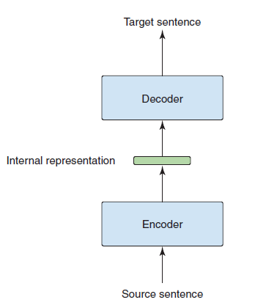
Neural machine translation - Encoder-decoder models

Slide 47
Content-based Image Search

Slide 48
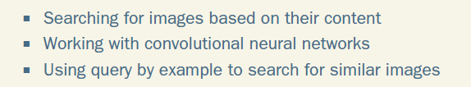
Content-based image search

Slide 49
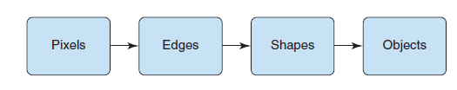
Image contents and search
Learning image abstractions incrementally

Slide 50

Understanding images
Some images described as “tall man”

Slide 51
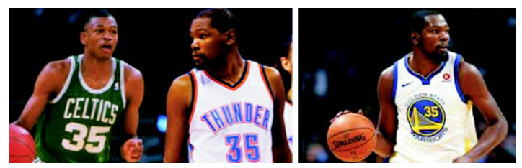
Understanding images
Some images described as “basketball player wearing a 35 numbered jersey”

Slide 52
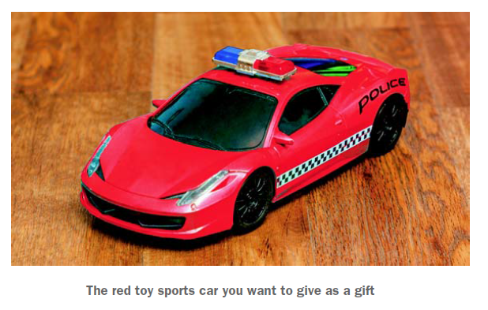
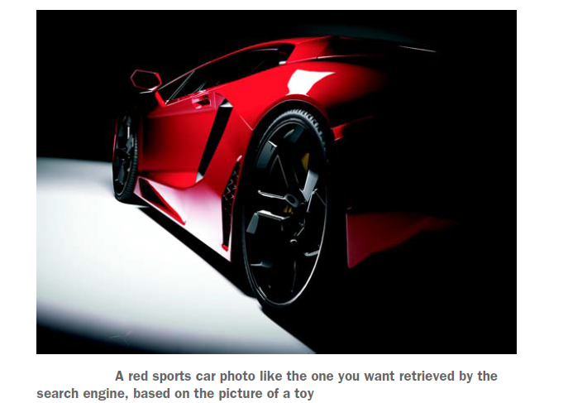
Image representations

Slide 53
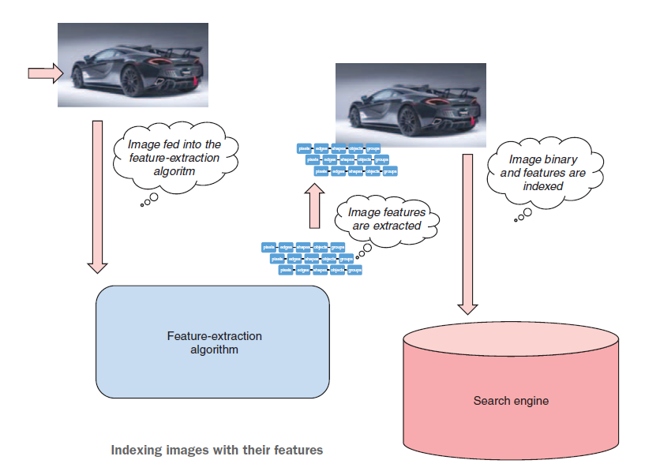
Indexing images with their features

Slide 54
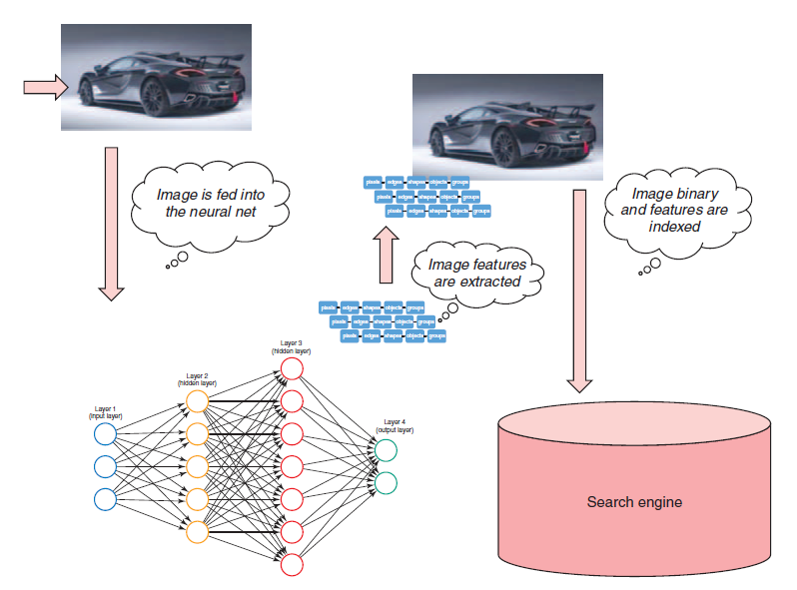
Indexing images with their features, extracted by a neural network

Slide 55
Thank You

